Slide 1


An Analysis into WallStreetBets and GameStop

Slide 2
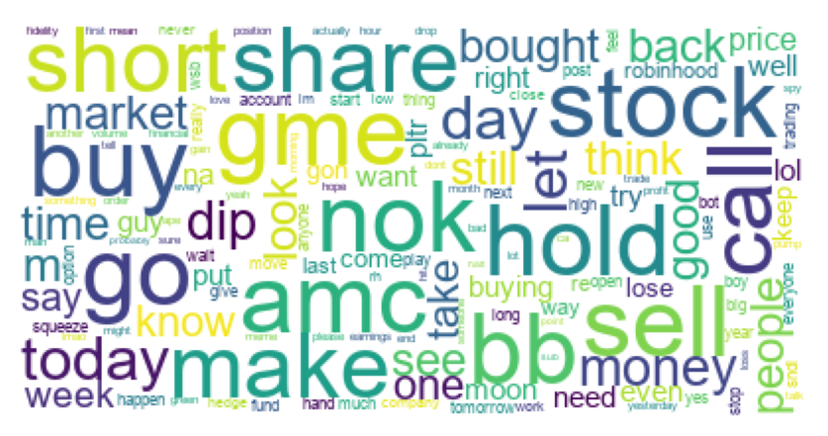
Content
GameStop Price History
GameStop Short Squeeze?
Motivations
Scraping Reddit
Analysis of Comments
  Vader Sentiment Analysis
  A Look into SNDL,APHA, TLRY
  GameStop Sentiment

Slide 3
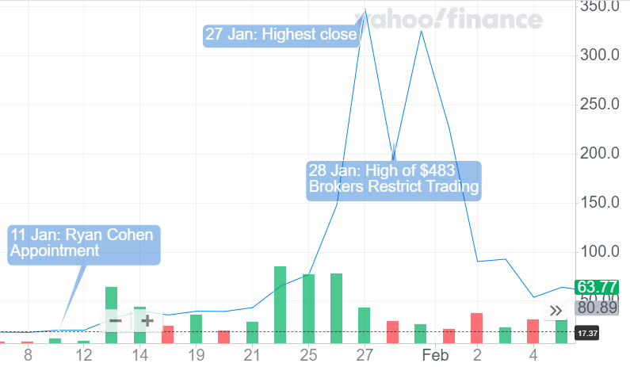
GameStop Price History
Through 2020 GME heavily shorted
Lowest price YTD was $2.57 on April 2020
Highest $483 on January 2021
Gain of 18,694%
GME ‘short squeeze’ 25th Jan – 1st Feb?

Slide 4
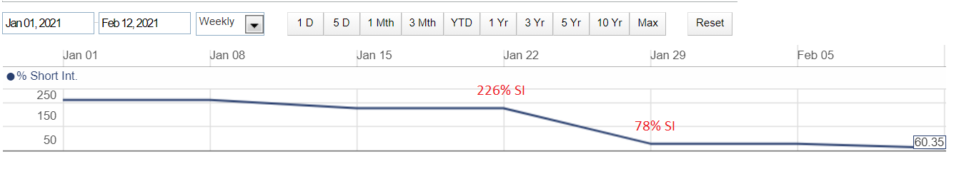
GameStop Short Interest
How Shorting works:
Believe company will perform badly
Borrow shares off someone and sell immediately
When price goes down, you buy back and give share back.
SI/Short interest – shorts not covered/closed out
https://finra-markets.morningstar.com/

Slide 5
GME Short Squeeze - VW 2008 Short Squeeze

Slide 6
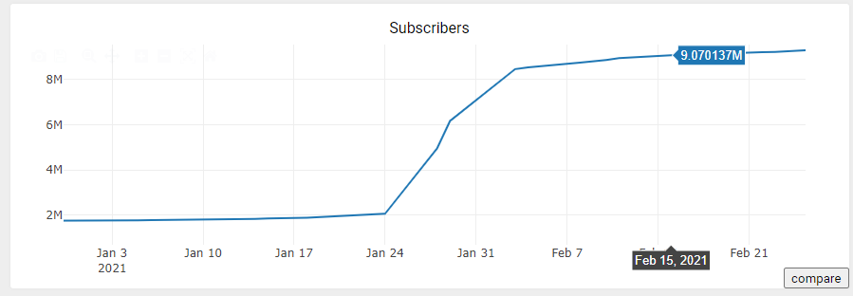
Motivations
Has the sentiment of GameStop changed through time?
Infiltrated by Bots?
Growth of WallStreetBets from (1.7m to >9m) - Stock Pump and Dump
Using Reddit comments as a predictor to stock price?
https://subredditstats.com/r/wallstreetbets

Slide 7
Scraping Reddit
Taken ‘Daily Discussion’ Threads from WallStreetsBets from 18th January to 26th Feb
Note: Some days there is dedicated GME threads
Excluded Weekends and US public Bank holidays (18th Jan/ 15th Feb)

Slide 8
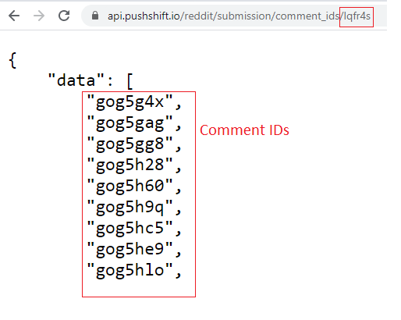
Scraping Reddit - Pushshift API
PushShift is a big-data storage and analytics project started and maintained by Jason Baumgartner*
Provide enhanced functionality and search capabilities for searching Reddit comments and submissions.
Given a submission id (thread ID)
Use Pushshift API to obtain list of comment IDs
E.g. https://api.pushshift.io/reddit/submission/comment_ids/lqfr4s
*https://www.reddit.com/r/pushshift/comments/bcxguf/new_to_pushshift_read_this_faq/

Slide 9
Scraping Reddit - PRAW
PRAW = Python Reddit API Wrapper
Requires Reddit Developer Account
Data extracted – Comment body, author, timestamp
  100 comments takes ~1min 40s.
API is rate limited
To speed up scraping, used multithreading with 4 Developer accounts connecting to Reddit API

Slide 10



Scraping Reddit Comments
PushShift
API
Submission ID
Comment IDs
Aggregate to Dataset
PRAW Agents

Slide 11
Daily Comment Count
Total Comments – 1,871,912
Removing deleted comments – 1,255,602

Slide 12
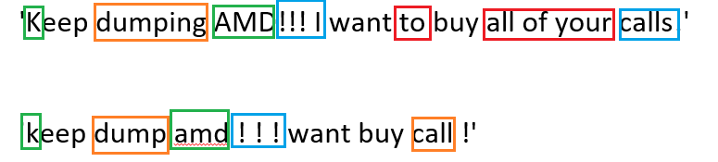
Preparing the Data
Removed Deleted/Removed Comments
Lowercase
Removed stopwords
Tokenize data (NLP TweetTokenizer)
Lemmisation
E.g.

Slide 13
Most common Emoji/words
Rank | Emoji | unigram | bigram
1 | 🚀 | amc | {amc,amc}
2 | 💎 | gme | {nok,nok}
3 | 🙌 | go | {gme,amc}
4 | 🦍 | buy | {hedge, fund}
5 | 😂 | hold | {buy, dip}

Slide 14
Sentiment Analysis of comments
Vader Sentiment analysis
Why: Can handle Emojis, unsupervised, punctuations
Changes to Vader
Added in Loughran and McDonald Financial Wordlist with Sentiments^{[1]}
Negative | Positive
volatile | surpass
suspends | rebound
sued | outperform
penalized | lucrative
overvalued | innovator
layoffs | booming
illegally | surpasses
Example of Negative and Positive words from Loughran and McDonald word list
[1] https://sraf.nd.edu/textual-analysis/resources/#LM%20Sentiment%20Word%20Lists

Slide 15
Improving Vader Analysis
Manually adding in words/emoji specific to WSB.
  Positive Emojis: 🚀📈💰💵
  Negative Emojis: 📉
  Positive words: moon, buy, bullish, calls
  Negative words: sell, dump, puts, bearish
E.g. Previously negative, now positive
'Keep dump amd!!! want buy all calls!'

Slide 16
Top stock mentions per day
 | Rank 1 | Rank 2 | Rank 3 | Rank 4 | Rank 5
19/01/2021 | BB | GME | PLTR | TSLA | AAPL
20/01/2021 | BB | GME | PLTR | TSLA | AAPL
21/01/2021 | BB | AAPL | AMD | GME | PLTR
22/01/2021 | BB | GME | PLTR | AMC | AMD
25/01/2021 | BB | GME | NOK | AMC | PLTR
26/01/2021 | BB | GME | NOK | PLTR | AMD
27/01/2021 | NOK | AMC | GME | BB | NAKD
28/01/2021 | GME | AMC | NOK | BB | APPS
29/01/2021 | GME | AMC | BB | NOK | TSLA
01/02/2021 | AMC | GME | BB | NOK | SNDL
02/02/2021 | GME | AMC | BB | NOK | PLTR
03/02/2021 | GME | AMC | BB | SNDL | NOK
04/02/2021 | GME | AMC | BB | NOK | PLTR
05/02/2021 | GME | AMC | BB | PLTR | TSLA
08/02/2021 | GME | AMC | OCGN | PLTR | BB
09/02/2021 | TLRY | APHA | GME | SNDL | CRSR
10/02/2021 | SNDL | APHA | TLRY | GME | TSLA
11/02/2021 | SNDL | GME | APHA | TLRY | HYLN
12/02/2021 | GME | SNDL | PLTR | APHA | TLRY
16/02/2021 | PLTR | GME | APHA | AMC | BB
17/02/2021 | PLTR | GME | TSLA | BB | AAPL
18/02/2021 | PLTR | GME | AMC | AAPL | BB
19/02/2021 | PLTR | GME | SNDL | BB | TSLA
22/02/2021 | PLTR | GME | TSLA | AMC | BB
23/02/2021 | AMC | TSLA | PLTR | GME | NIO
24/02/2021 | GME | AMC | PLTR | TSLA | BB
25/02/2021 | GME | AMC | PLTR | NOK | BB
26/02/2021 | GME | AMC | PLTR | RKT | TSLA
GME: GameStop
BB: BlackBerry
NOK: Nokia
PLTR: Palantir
SNDL: Sundial Growers
APHA: Aphria
TLRY: Tilray
TSLA: Tesla
AAPL: Apple
From NASDAQ and NYSE

Slide 17
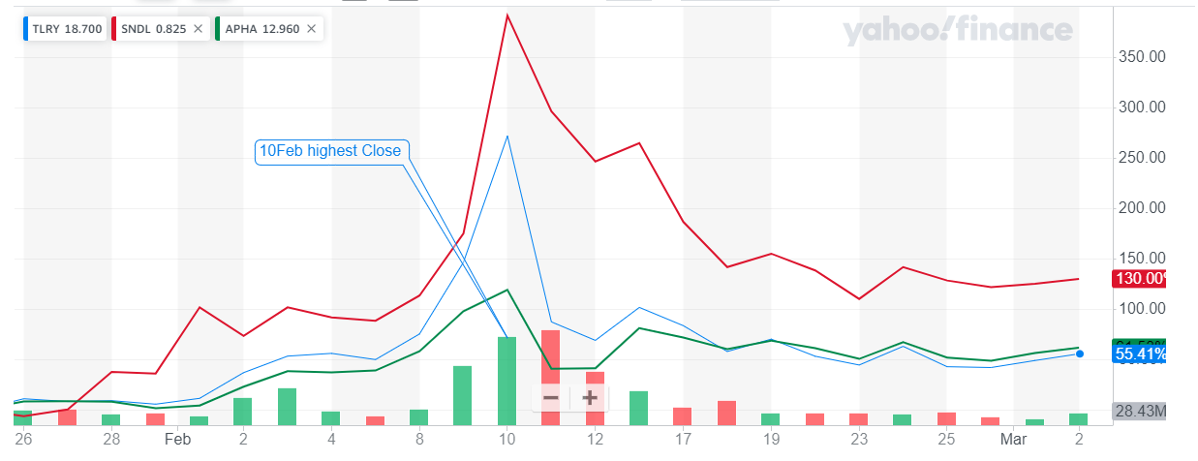
SNDL, APHA, TLRY - Price

Slide 18
SNDL, APHA, TL – Sentiment
Negative Sentiment increases between 9th – 12th Feb.

Slide 19
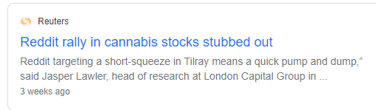
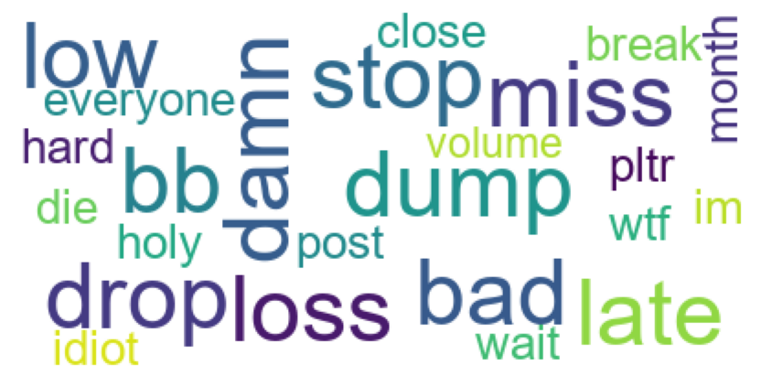
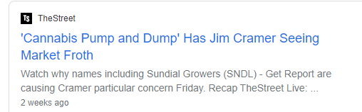
SNDL, APHA, TL – Negative Words*
*Not in top 100 positive words (Comments taken from 9-12th Feb)
Pump and Dump?

Slide 20
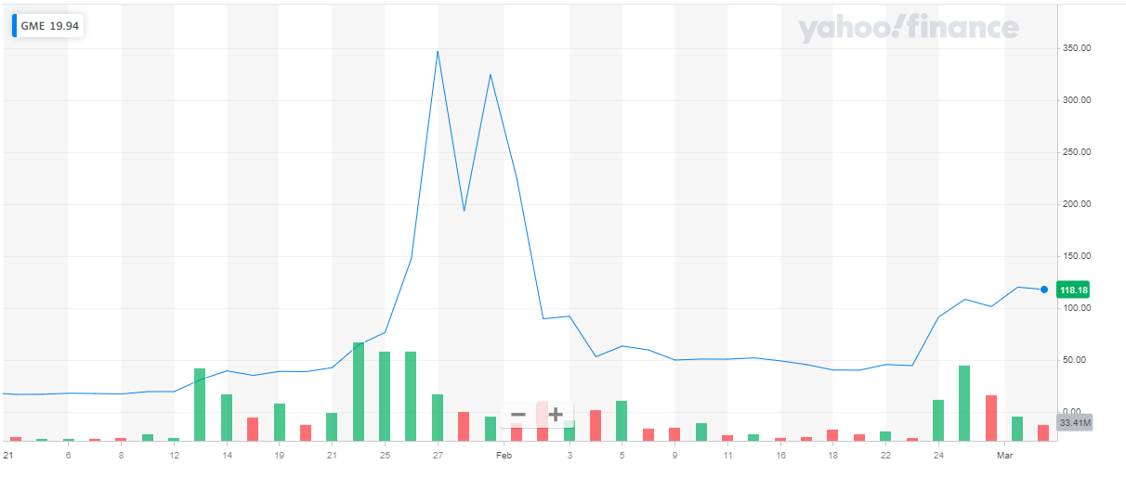
GameStop Price

Slide 21
GameStop Sentiment

Slide 22
GameStop Vs Rest Sentiment
Comments involving GameStop more opinionated?

